Slide 1
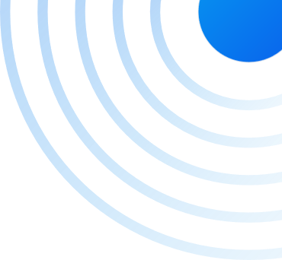


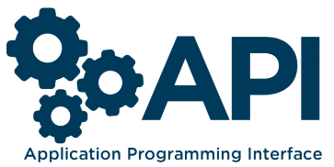
COD3R-GPT
AI Chatbot with Open-AI's GPT-3 API
A State Of The Art- Language Model

Slide 2
CONTENTS
PART 01
PART 02
PART 03
PART 04
Introduction
Technologies Used
Key Objectives
Why Chat GPT Clone ?

Slide 3
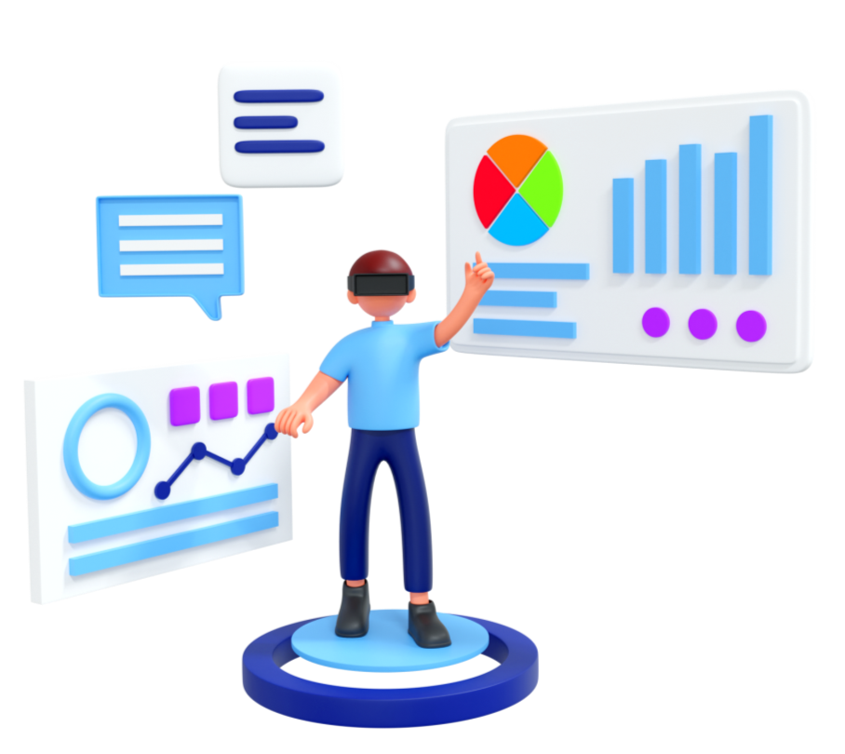
01
Introduction
Project Overview
This project, known as "(COD3R-GPT)," aims to leverage the power of OpenAI's GPT-3

Slide 4

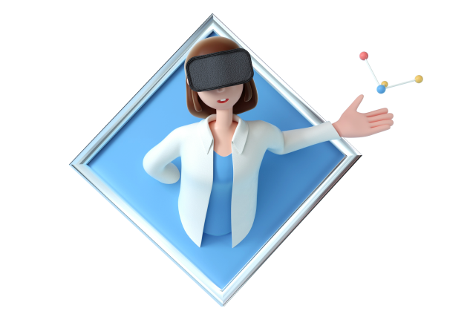
Technologies Used
HTML/CSS
JAVASCRIPT
HTML/CSS is the backbone of web pages and is used to structure the content on a webpage.
JavaScript is a versatile and powerful programming language that adds interactivity and dynamic behavior to web pages.
REACT
Open-AI GPT-3 API
React is a free and open-source front-end JavaScript library for building user interfaces based on components.
The Open AI GPT-3 API is integrated to provide the chatbot's natural language understanding and generation capabilities.

Slide 5
WHAT COD3R-GPT CAN DO ?
Answer Questions
Generate Content
Language Translation
Can provide information, explanations, and answers to a wide range of questions on various topics.
Can create written content, including articles, stories, and marketing copy, tailored to your specific needs.
Can help translate text from one language to another, making it easier for you to communicate across language barriers.

Slide 6
Key Concepts and Functions
State
Management
Use Effect
Hook
100%
70%
Asynchronous
Function
User Interface Development
60%
65%
30%
Handling User Submissions
API Integration
20%

Slide 7
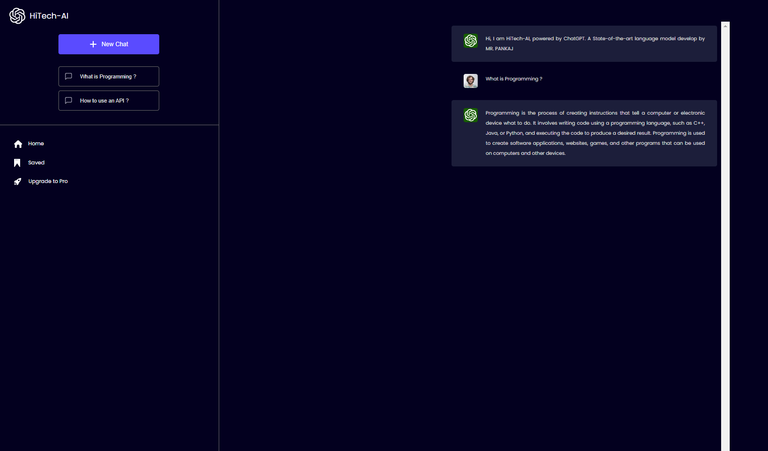

Add title text
Click here to add text content, such as keywords, some brief introductions, etc.Click here to add content, content to match the title.
Add title text
Click here to add text content, such as keywords, some brief introductions, etc.Click here to add content, content to match the title.
Add title text
Click here to add text content, such as keywords, some brief introductions, etc.Click here to add content, content to match the title.

Slide 8
Key Objectives
Implement the GPT-3 API
Customization and Training
User Interaction
Enhanced User Experience
Deployment and Scaling
Feedback Loop

Slide 9
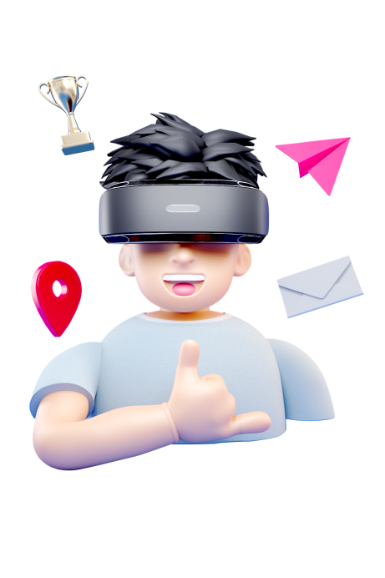
Why HiTech AI (Chat GPT Clone) ?
Click here to add text content, such as keywords, some brief introductions, etc.Click here to add text content, such as keywords, some brief introductions, etc.
Enhanced User Experience
Efficiency and Automation
Chat GPT Clone can significantly improve user interactions on websites and applications, offering natural and engaging conversations, thus enhancing user satisfaction.
It automates tasks, answers queries, and generates content, reducing the need for manual intervention, thereby saving time and resources.
Versatility
AI Advancements
Chat-GPT Clone can be customized for various applications, from customer support to content creation, making it a versatile solution for different industries.
Leveraging OpenAI's GPT-3 technology ensures access to cutting-edge natural language processing capabilities, keeping your chatbot at the forefront of AI innovation.

Slide 10
THANKS
www.pptxtemplates.com

